Slide 1
Baseball Statistics
By Kieran Pfann & Elvis Mercado

Slide 2
System Description
A website that allows a user to search and filter through baseball statistics
Can be built using HTML, Bootstrap and JS for the front end, along with Flask and, obviously, SQLITE3 for the backend
User will be able to search through players, coaches, teams, games and seasons and be able to look up all of the data that a user could want
Displays the data for each table in a different section of the site, e.g. you would be able to look at the data in the players table or teams table and then filter from there

Slide 3
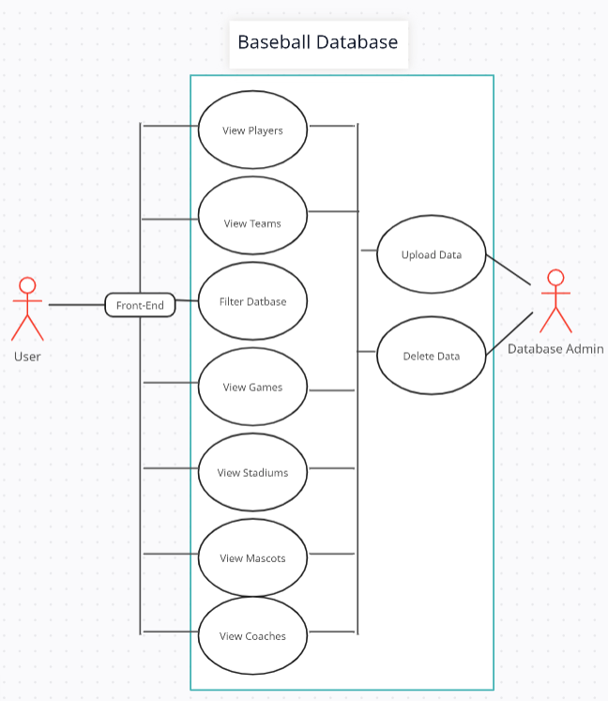
Use Cases
There will be 2 main users one being the user of application who will use front end to filter database and there will be a database administrator who is in charge of maintaining and updating the database.

Slide 4
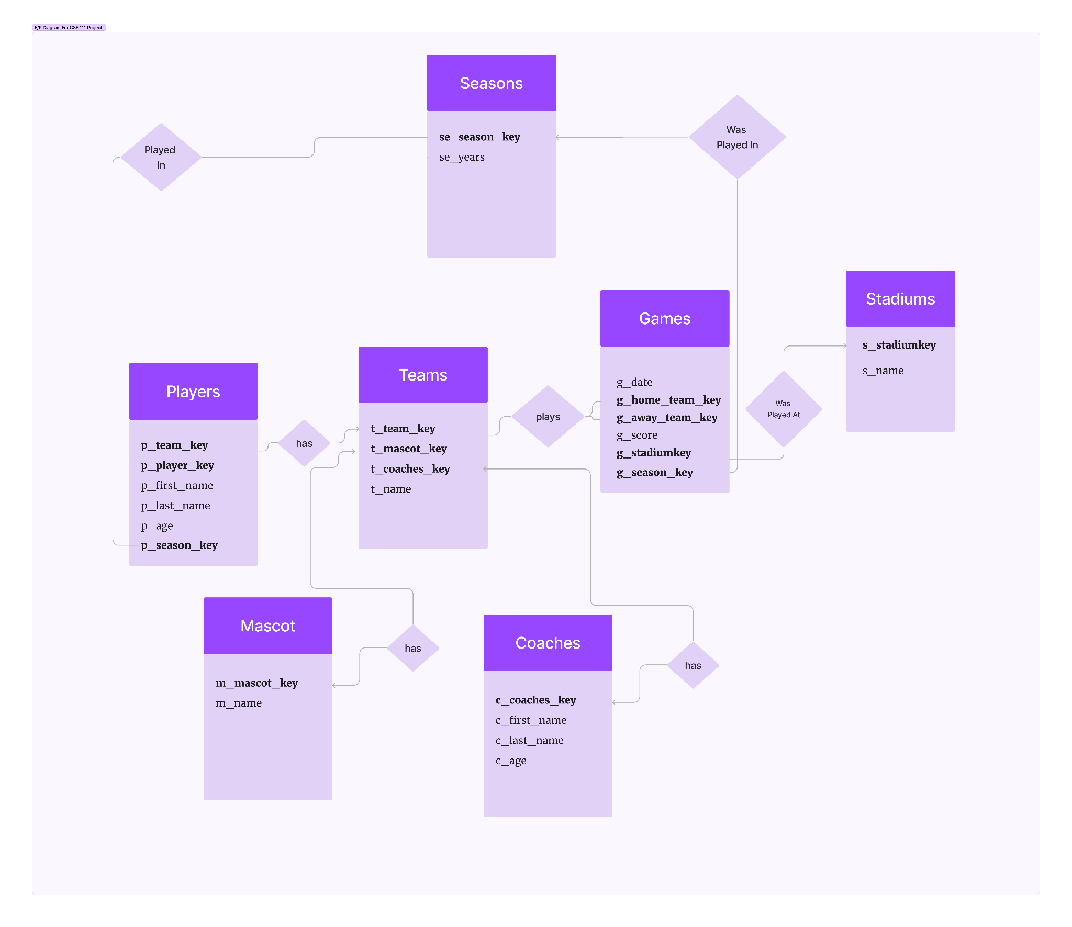
ER Diagram
& Schema
Key INT()
Name VARCHAR (50)
Age INT()

Slide 5
Implementation Details
IDE - VisualStudio Code
Database - sqlite3
Flask - micro web framework
Language - SQL, python

